Slide 1


PROJECT ESFP-1 {PID045} Real time Artificial Intelligence (AI) based Data Analysis and reading

Slide 2


Problem
Solution
work file management and manual data analysis
Makes it fast and solves data management

Slide 3
Contents of This Template
Registration and Login: The program should have a registration process for both teachers and students. During registration, they would provide their basic information, including a username and password. After registration, they can log in using their respective usernames and passwords.
Teacher's Dashboard: When a teacher logs in, they are directed to their dashboard. In the dashboard, the teacher has several options: View Attendance Spreadsheet: The teacher can access a spreadsheet showing the list of students, which could optionally include their names. The teacher can choose to input attendance for each student by typing 'p' for present or 'a' for absent next to each student's name. The spreadsheet is automatically updated as the teacher inputs attendance data. View Student Percentage: The teacher can enter a student's name and view the percentage of classes that the selected student has attended. The program calculates this percentage based on the attendance data in the spreadsheet.

Slide 4
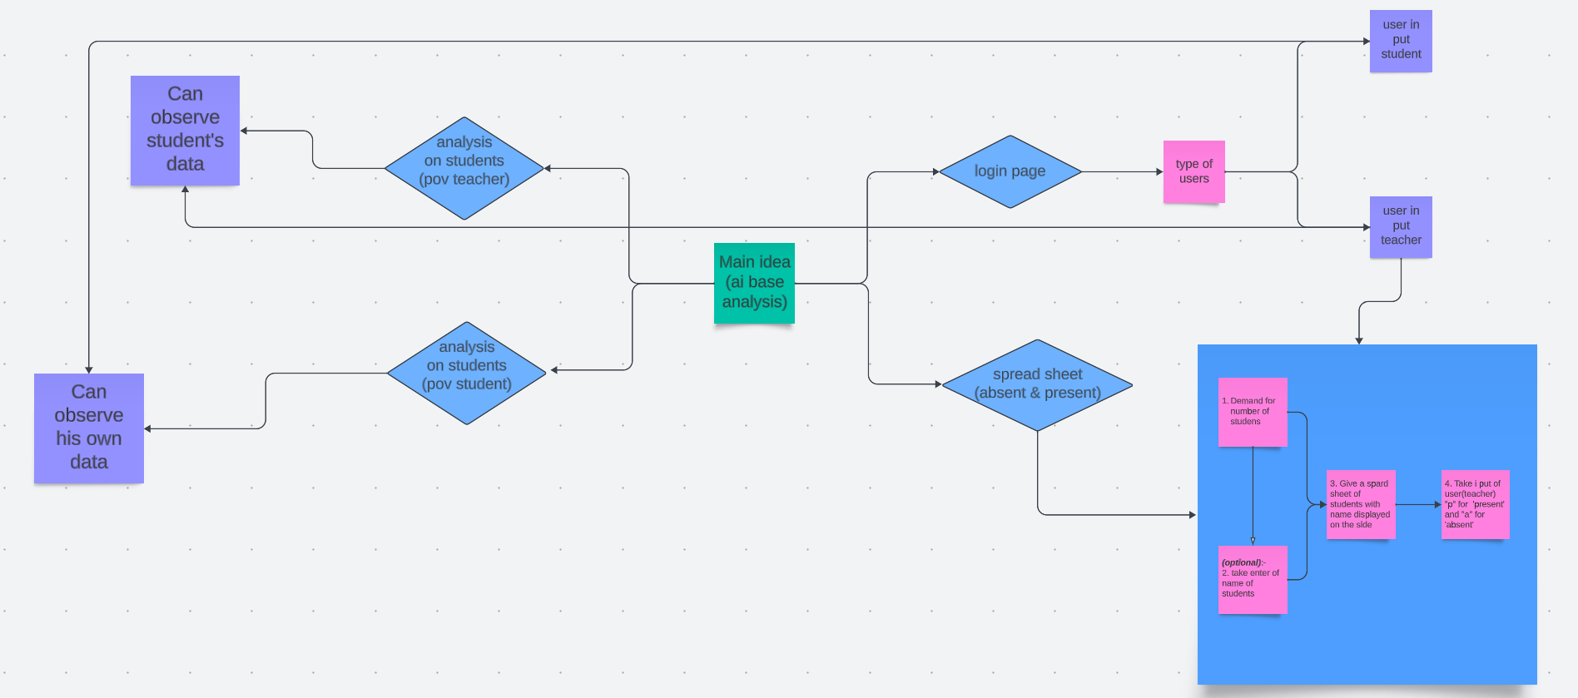

Slide 5

Table of Contents!
Overview
Assignment
You may also consider implementing a reporting feature that allows teachers to generate attendance reports for specific time periods or for specific students.
By following these steps, your program can effectively track student attendance

Slide 6

01
Student's Dashboard

Slide 7
55%
25%
75%
35%
Student’s Dashboard
Student A
Student C
Student B
Student D

Slide 8



Student's Dashboard:
When a student logs in, they are directed to their dashboard. In the dashboard, the student has the following option:
View Personal Attendance Status: The student can see their own attendance record. They can see how many classes they attended and how many they missed.

Slide 9
02
Teacher's Dashboard

Slide 10

Practical Uses of This Subject
Teacher's Dashboard:
. The teacher can choose to input attendance for each student by typing 'p' for present or 'a' for absent next to each student's name. The spreadsheet is automatically updated as the teacher inputs attendance data.
Work in Teacher fever

Slide 11


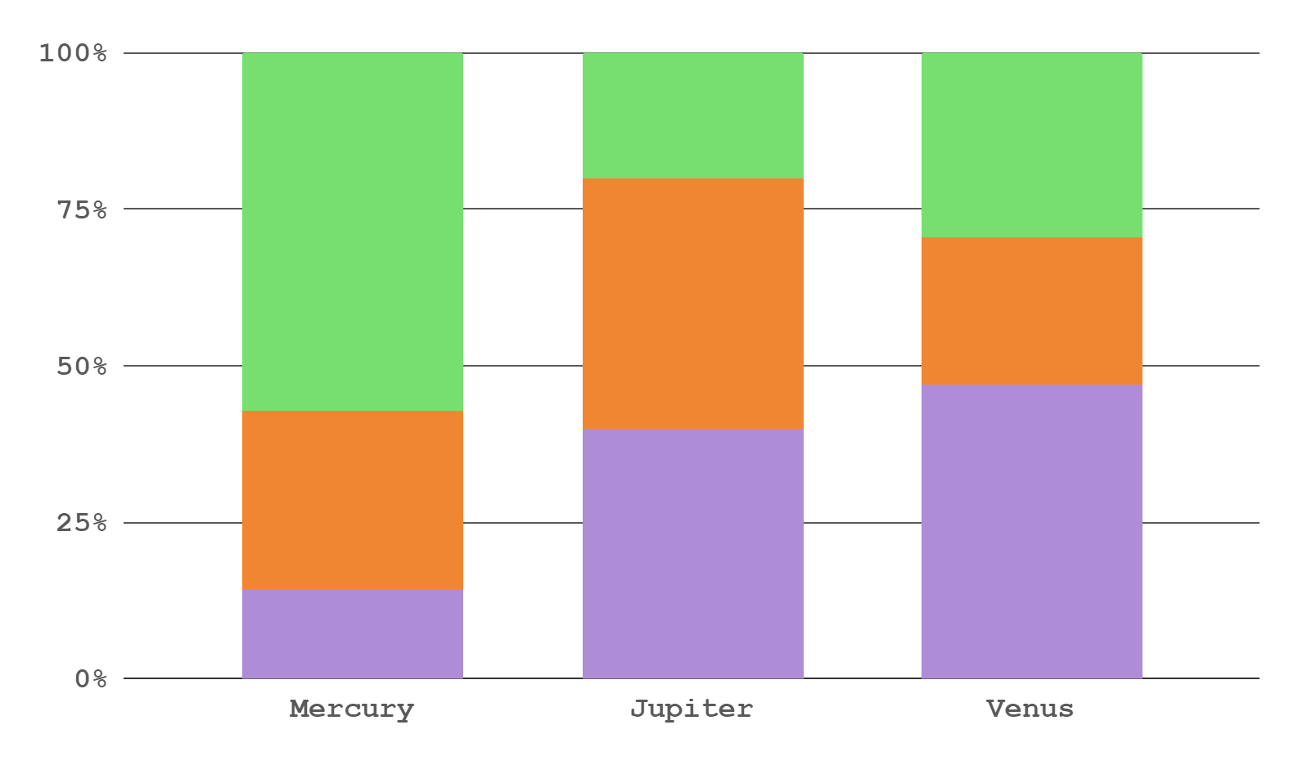
Did You Know This?
35%
65%
Teacher can read
Student A
Student B
Factor 1
Factor 2
Factor 3

Slide 12
Exam’s Grades
Grades
Student | Q1 | Q2
Last name, name | A+ | F
Last name, name | A | B
Last name, name | C | A
Last name, name | F | A+
Grades
Student | Q1 | Q2
Last name, name | C | A+
Last name, name | A+ | F
Last name, name | A | B
Last name, name | B | C

